Slide 1
Hadoop Infrastructure and SoftServe Experience
February, 2015
Pacemaker BigData, Lviv

Slide 2
Agenda
Business needs
Hadoop Infrastructure
Hadoop Distributives
SoftServe Experience

Slide 3
Presentation drivers
Hadoop competence development
Hadoop isn’t MapReduce only
Components for solution building
Case studies

Slide 4








Big Analytics Engineering Challenges
How to achieve Low Latency for personalized customer experience in real-time?
Real Time
Intelligence
Consumers
Intelligent Agents
How to implement Self-Service with high Data Quality over terabytes and petabytes?
How to improve System Performance for Data Science/
Analytics team?
Data
Discovery
Business
Reporting
Data Scientists/
Analysts
Business Users

Slide 5
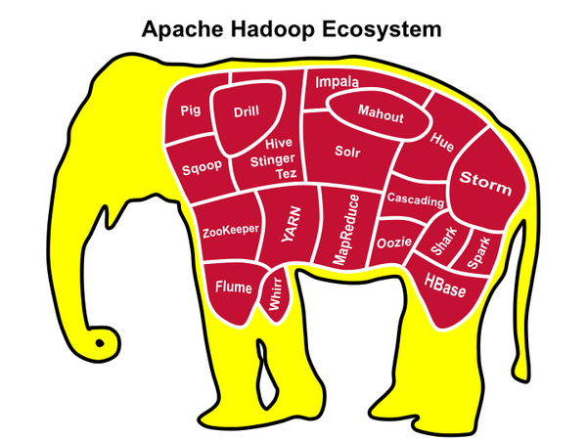

Slide 6

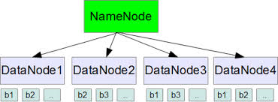
A distributed file system
Files are split into blocks
Each block has 3 replicas minimum

Slide 7

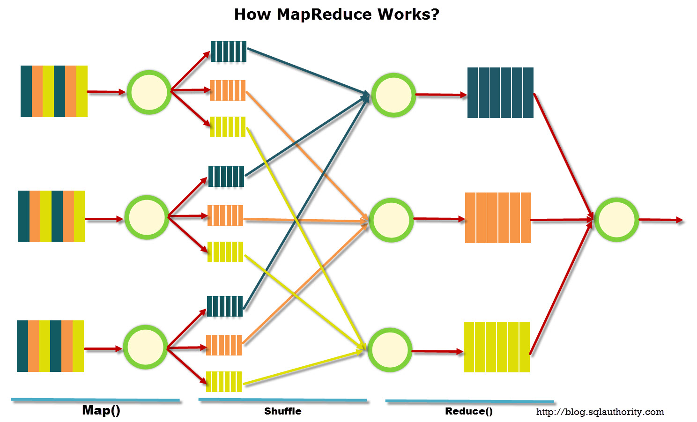
A distribute computing framework

Slide 8
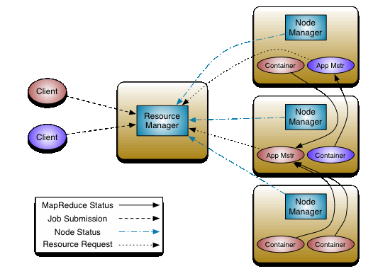
Apache YARN
A resource manager (Yet Another Resource Manager)

Slide 9

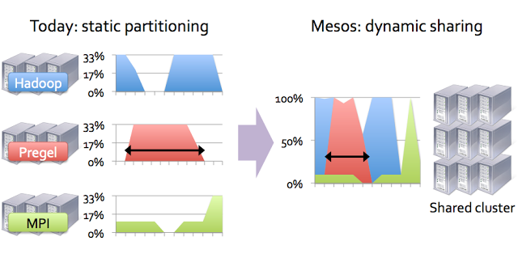
A more complex resource management

Slide 10

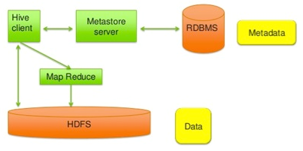
An SQL interpreter for MapReduce

Slide 11

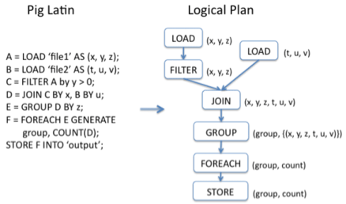
Apache Pig
A script language to query HDFS

Slide 12


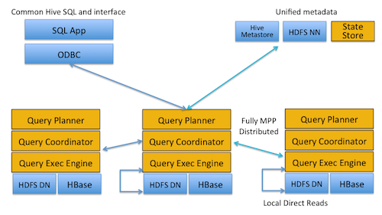
Real-Time Queries in Apache Hadoop

Slide 13

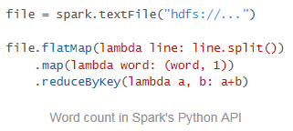
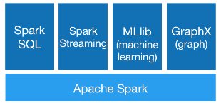

Engine for large scale data processing. Could be used with Java, Scala and Python
Runs Everywhere

Slide 14

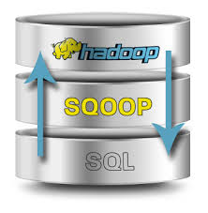
Apache Sqoop
SQL to HADOOP – data load tool for RDBMS

Slide 15

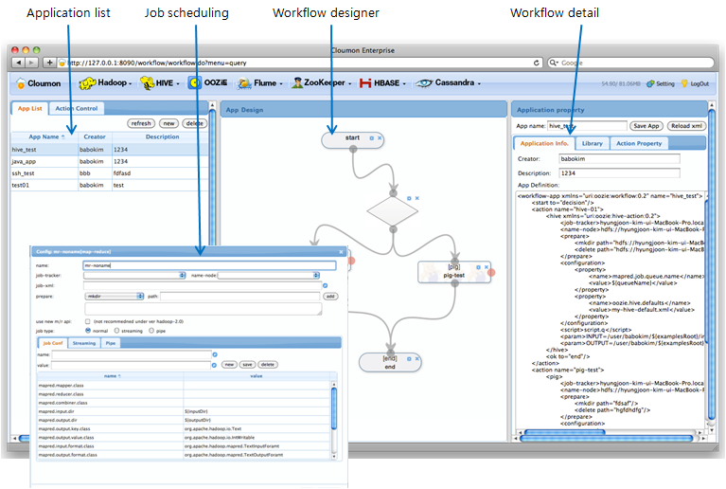

Slide 16


Other Databases on top of Hadoop
Column oriented Key-Value datastore
Graph oriented Database

Slide 17

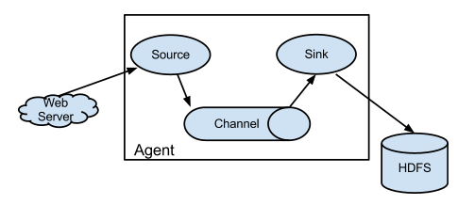
A distributed service for collecting, aggregating, transformation and moving large amount of log data

Slide 18

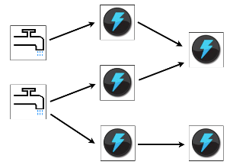
Distributed, real time computation service. Could be used for real time analytics, online machine learning, continuous computation, distributed RPC, ETL, and more

Slide 19

Apache Zookeeper
Distributed Service for:
maintaining configuration information
naming
providing distributed synchronization
providing group services
Service is fault tolerant:
Zookeeper cluster is called “ensemble”
There is one “leader” in an “ensemble”
If “leader” is down a new “leader” is elected with quorum

Slide 20

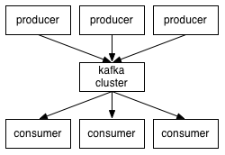
Distributed messaging service
Large amount of data
Scalable
Durable (messages are persisted on disc)

Slide 21





Popular Distributions

Slide 22
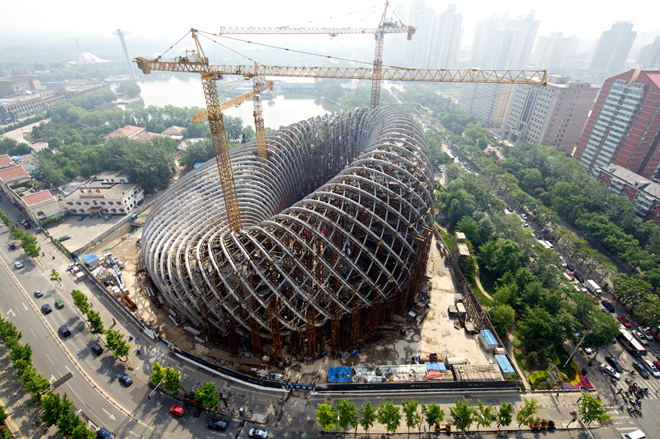
The last architecture trends

Slide 23
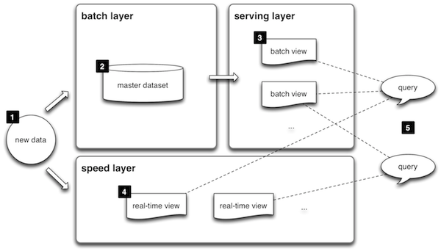
Lambda Architecture
http://lambda-architecture.net/

Slide 24
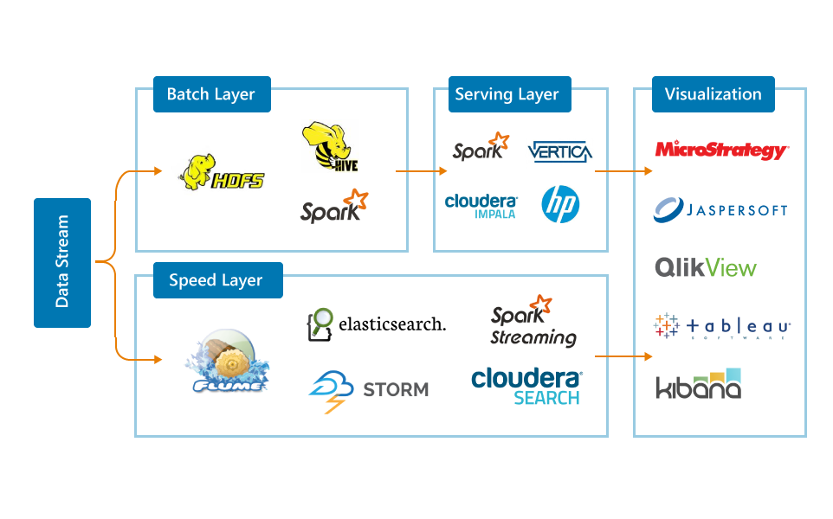
SoftServe Lambda Architecture Accelerator
Lambda Architecture – is a highly scalable and reliable data processing architecture based on Twitter successful experience in Big Data and Analytics
Supports majority of use cases: Real-time analytics, data discovery and business reports
SoftServe’s pre-built Lambda Architecture stack accelerates customer’s Time to Market to 15-20+ man/month

Slide 25
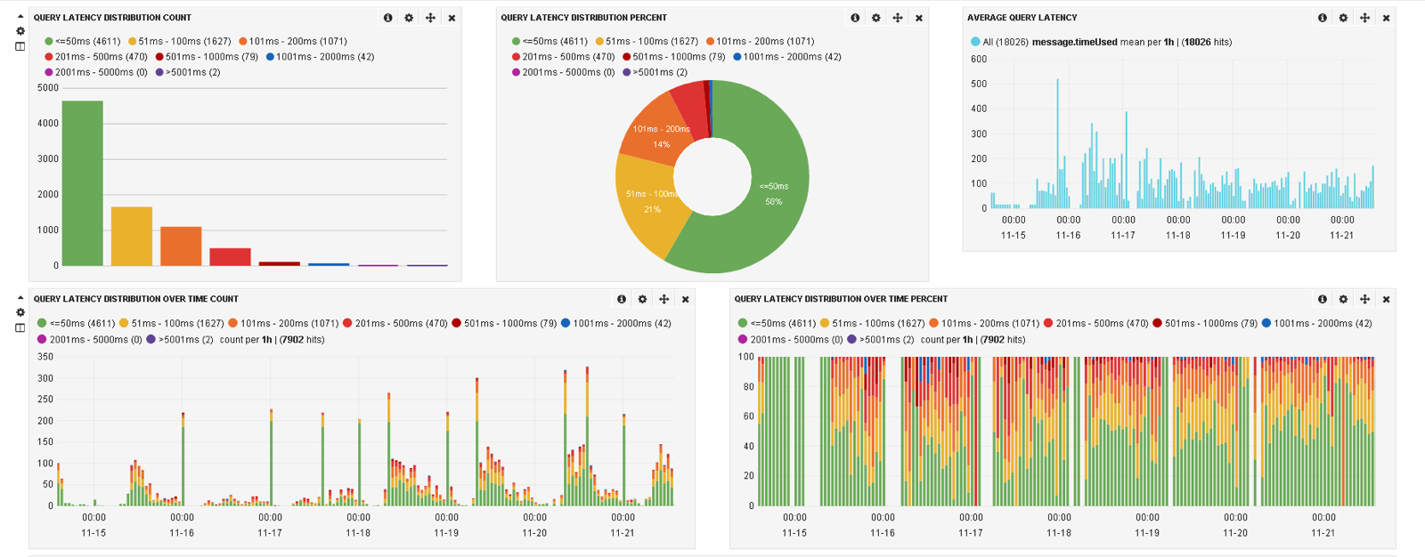
Big Data Lab: Log Management
Business Goals:
Build a centralized platform for log data analysis which collects data from ~270-300 Web Servers
Provide Online Monitoring to answer the question: “What is going on with systems now?”
Provide Retrospective Analytics – strategic management, capacity management/planning, route cause analysis, ad-hoc analysis
Business Area:
Retail industry. A leading travel site in a world
Notes:
Client
Our client is a leading travel site in a world.
Engagement
Partnering with SoftServe, the combined teams developed an and implementation of Hadoop Cluster which collects log data from ~270-300 Web Servers including HTTPD Access and Error logs, as well as Application Server Servlet and OS Service Logs for further operational and retrospective analysis.
Result
The client has decreased their time to react on a issues which happens with web-servers as well as increased insight into ROI analysis for marketing campaigns which enabled company to increase number of visitors.

Slide 26
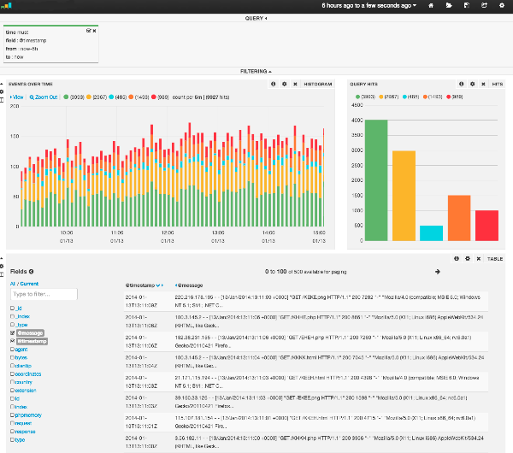
Log Data Analysis Platform Details
Key Facts:
~270-300 Web Servers
Log Types: HTTPD Access logs, Error logs, Application Server Servlet, OS Service Logs
~500K events per minute
150GB of data per day
Technologies:
Flume
Hadoop/HDFS, MapReduce
Hive, Impala
Oozie
Elasticsearch, Kibana
MicroStrategy Analytics platform

Slide 27
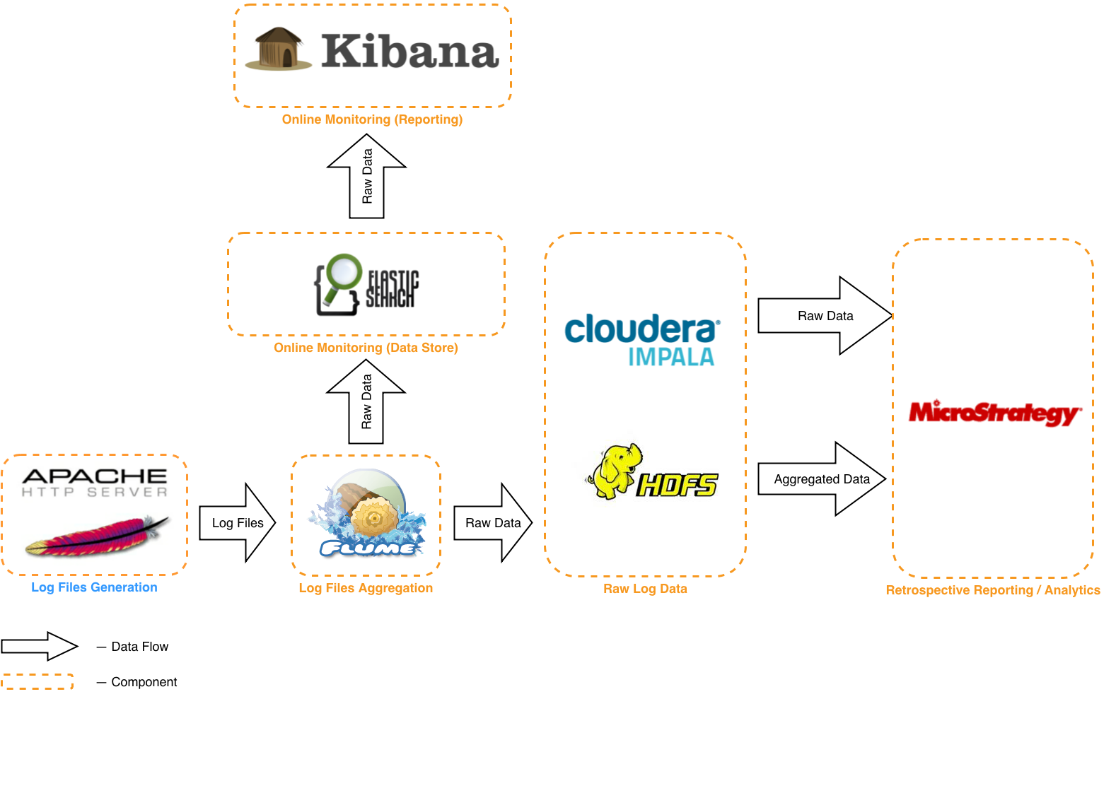
Solution Architecture

Slide 28

Case Study #1: Clickstream for retail website
Business Goals:
Build in-house Analytics Platform for ROI measurement and performance analysis of every product and feature delivered by the e-commerce platform;
Provide the ability to understand how end-users are interacting with service content, products, and features on sites;
Do clickstream analysis;
Perform A/B Testing
Business Area:
Retail. A platform for e-commerce and collecting feedbacks from customers

Slide 29
Architectural Decisions
Architecture Drivers:
Volume (45 TB)
Sources (Semi-structured - JSON)
Throughput (> 20K/sec)
Latency (1 hour/real-time)
Extensibility (Custom tags)
Data Quality (Not critical)
Reliability (24/7)
Security (Multitenancy)
Self-Service (Canned reports, Data science)
Cost (The less the better ☺)
Constraints (Public Cloud)
Technology Stack:
Apache Kafka
Apache Storm
Amazon S3
Hadoop/HDFS, MapReduce (CDH 5)
HBase
Oozie, Zookeper
Cloudera Manager
Lambda
Architecture

Slide 30
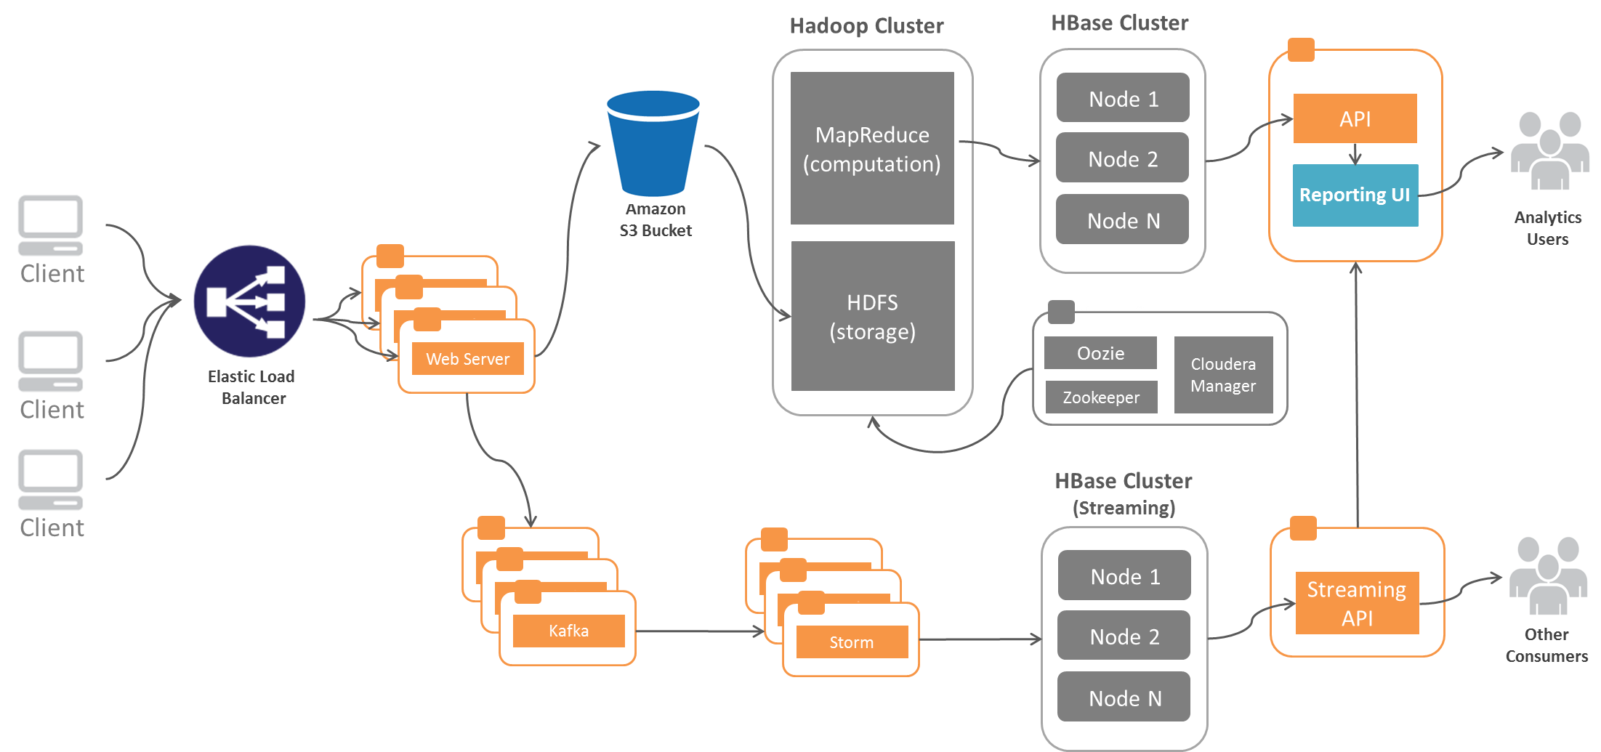
Solution Architecture

Slide 31


Case Study #2: Coupon Marketplace
Business Goals:
In-house Web Analytics Platform for Conversion Funnel Analysis, marketing campaign optimization, user behavior analytics (based on server logs analysis, page tagging, external data);
Perform A/B Testing, platform feature usage analysis
Business Area:
Retail. The world's largest digital coupon marketplace. The company owns the largest coupon sites in the US, UK, Germany, Netherlands, France
Notes:
Clickstream Data:
Google Analytics
Site Catalyst, SaaS App from Adobe (prev. Omniture)
Apache Web Logs
Beacon JavaScript Library
Financial Data:
Data, provided by Affiliate Networks though API, FTP etc
Marketing Data:
Kenshoo: used as a platform to analyze the effectiveness of pay per click Google Ad campaigns.
The Kenshoo Conversion Feed provides sales and commission data to measure ROI on campaigns

Slide 32
Coupon Marketplace: Project Details
Project Facts:
500 million visits a year
25TB+ HP Vertica Data Warehouse
50TB+ Hadoop Cluster
Near-Real time data visualization
Technology Stack:
Hadoop Cluster (Amazon EMR) /Hive/Hue/MapReduce/Flume/Spark
HP Vertica, MySQL
Python
Tableau
Major Activities:
Near-Real time data integration processes design and implementation
Hadoop cluster optimization
Data Warehouse re-design and optimization
Data Science algorithms design

Slide 33


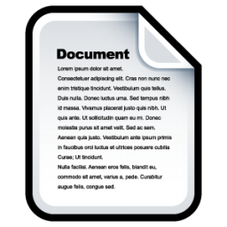







Coupon Web Analytics Platform
Coupon Web-Site
JS Libs
Web Logs
Operational
databases
Raw Data Hadoop Cluster
Coupon Web-Site
Data Scientists
ETL Additional Data Stores
JS Libs
Web Logs
Operational
databases
3rd Party API
BI/Marketing Team
MPP Data Warehouse Cluster
REST/SOAP

Slide 34


Case Study #3: Online Analytics Platform
Business Goals:
Insights and optimization of all web, mobile, and social channels
Optimization of recommendations for each visitor
High return on online marketing investments
Business Area:
Web Analytics Platform by Fortune 100 company is a data storage and analytics on visitors' digital journeys

Slide 35
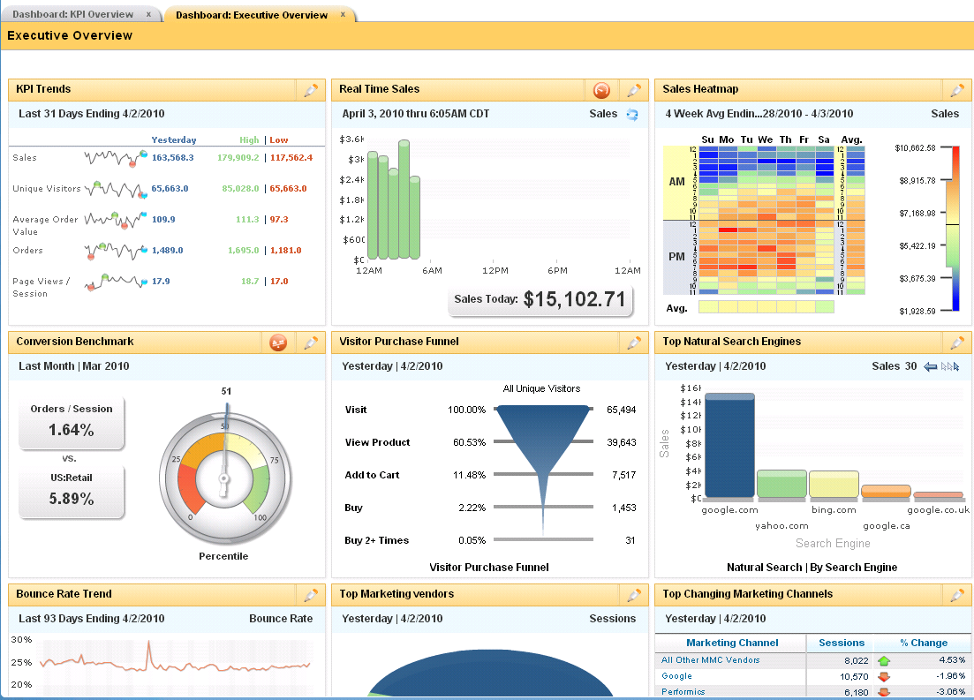
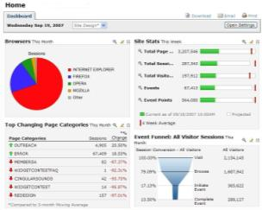
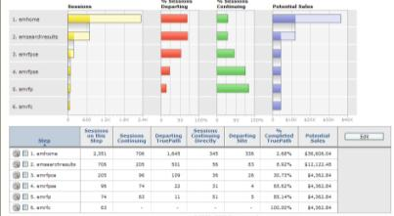
Online Analytics Platform Details
Key Facts:
Big Data > 1PB
10+ GB per customer/day
10+ Hadoop Clusters
15+ Aster Data Clusters
Technologies:
Hadoop/HBase/HiveQL
Aster Data
Oracle
Java/Flex
Notes:
Tools & Technologies Extended List:
SaaS, Hadoop/HDFS, Hadoop/Hbase, Aster Data, Java/Flex, J2EE, Java Script, Scape SSH/SFTP library, Velocity, Linux, Bash RDL, SQL, XSL Java, XML, Oracle database, JMS, Java Servlet, JDBC, JBoss, Flash RDL, Macromedia Flash.

Slide 36









Solution Architecture
Customer Marketing Team
Web Analytics Platform
Offerings
Business Rules
Schedule
Customer Web Server Environment
Web Analytics Data
Recommendation
Rule Engine
Notes:
Hadoop/HiveQL:
Raw data about website users behavior
Aggregation information for historical analytics
Customized scheduled reports
HBase: Online query for immediate data access:
User geographical and demographics information
Recent user purchase, search, unsubscribe activities

Slide 37



Further learning
http://bigdatauniversity.com/
http://blog.cloudera.com/blog/
http://hortonworks.com/blog/
https://www.mapr.com/blog
Hadoop: The Definitive Guide, 3rd Edition

Slide 38

Any questions, Dude?

